Slide 1


BOOK A DOCTOR USING MERN A seamless way to book medical appointments online

Slide 2
TEAM MEMBERS: VIJAYALAKSHMI.A-310821205109 PRADEEPA. U -310821205062 RITHIGA .K- 310821205074 NIVETHA .M-310821205057

Slide 3
Introduction:
INTRODUCTION:
The healthcare industry is undergoing a digital transformation, focusing on streamlining processes to enhance the experience for both patients and providers.
Traditional appointment booking systems often involve:
Long waiting times.
Inefficient manual processes.
Lack of transparency in availability.
These issues highlight the need for a seamless, digital solution to bridge the gap between patients and healthcare providers.

Slide 4
: SOLUTION:
A web-based platform for users to search, view, and book appointments with doctors easily.
Easy navigation for patients to search for doctors by specialty, location, and availability.
Quick and hassle-free appointment booking.
TECH STACK:
MERN (MongoDB, Express.js, React.js, Node.js)
Front end (HTML,CSS,JS)
Back end ( React.js, Node.js, MongoDB)

Slide 5
OBJECTIVE:
The primary objective of this project is to develop a robust and user-friendly web platform for booking medical appointments. It aims to streamline the process for patients by enabling them to search for doctors, view availability, and book slots effortlessly. For doctors, it provides tools to manage schedules and appointments efficiently.
This system ensure secure data handling using MongoDB and offers a scalable architecture for future enhancements. Ultimately, it seeks to bridge the gap between patients and healthcare providers, promoting convenience and accessibility.
Centralized System:
Secure storage of patient, doctor, and appointment data using MongoDB.
Role-based access for users, doctors, and administrators.
Scalable and Flexible:
Built on the robust MERN stack, allowing for future enhancements such as payment integration and telemedicine services.

Slide 6
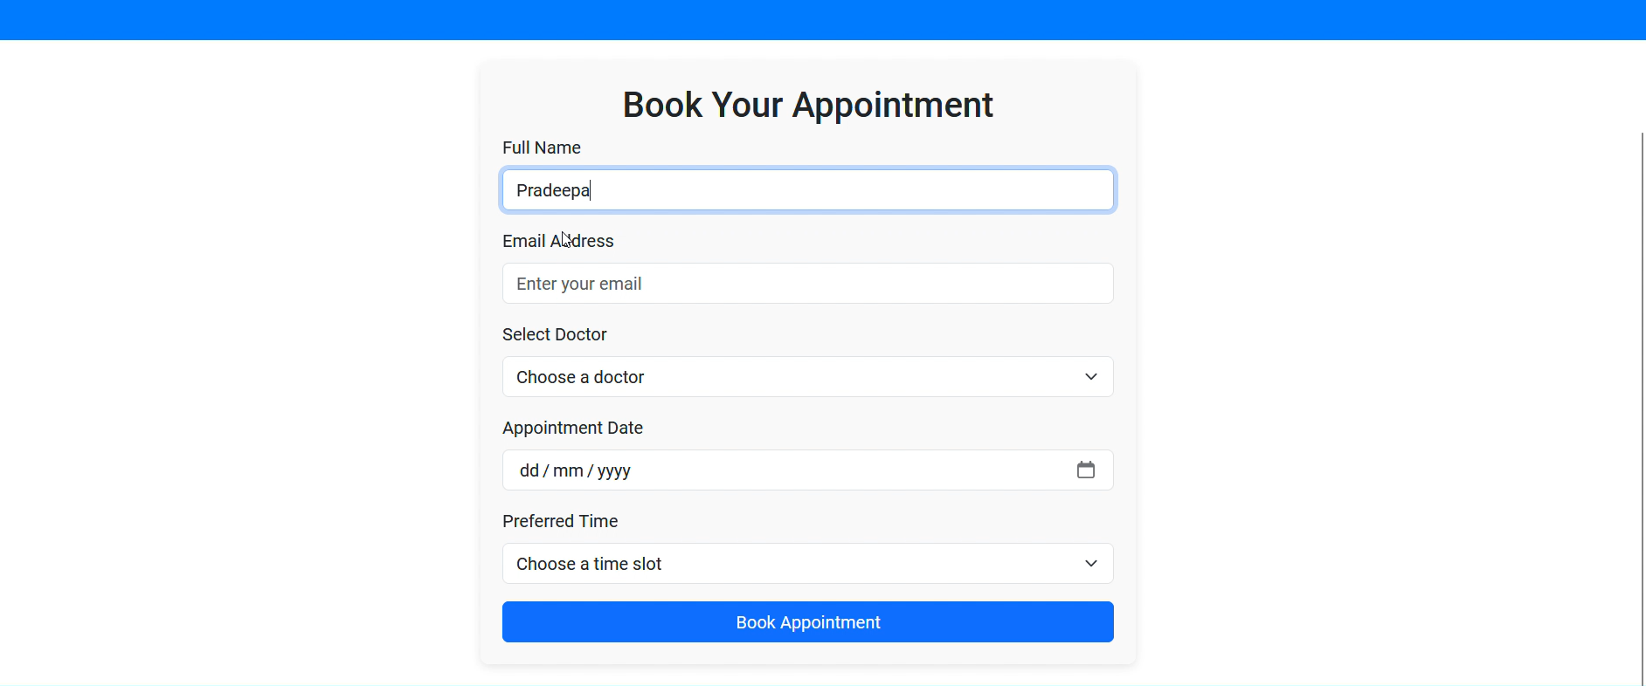
Screenshots and demo:

Slide 7
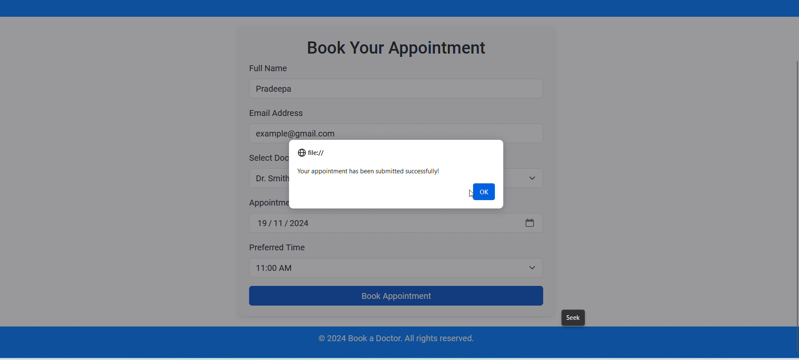

Slide 8
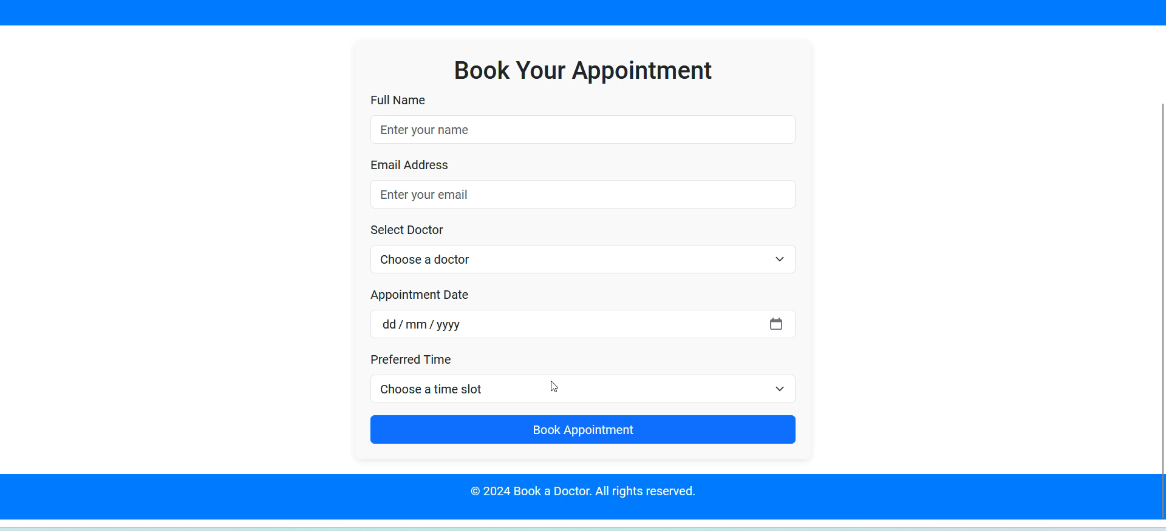

Slide 9
FEATURES:
Input Fields:
Full Name: To identify the patient.
Email Address: For confirmation and notifications.
Select Doctor: Dropdown to choose the desired doctor.
Appointment Date: Calendar picker for easy date selection.
Preferred Time: Dropdown for available time slots.
Call to Action:
A clear "Book Appointment" button to confirm the booking.

Slide 10
BACKEND (MERN):
MongoDB (Database)
Stores user data (e.g., name, email), appointment details (doctor, date, time), and doctor information securely.
Facilitates efficient querying to fetch or update available slots and appointment history.
Express.js (Backend Framework)
Manages server-side logic and routes for the application.
Handles API requests such as:
Booking appointments (POST /appointments)
Fetching available doctors (GET /doctors)
Checking available time slots (GET /availability)
Ensures smooth communication between the frontend and database.

Slide 11
BACKEND(MERN):
Node.js (Runtime Environment)
Powers the backend server to process requests and handle concurrent user interactions efficiently.
Integrates with MongoDB for real-time data updates.
Security Features
User Authentication: Secure login/signup with JWT (JSON Web Tokens).
Data Protection: Encrypt sensitive data using secure hashing algorithms (e.g., bcrypt).
API Security: Use middleware to prevent unauthorized access to endpoints.
Validation: Server-side validation for form inputs to avoid SQL injection and XSS attacks.

Slide 12
Performance Optimization
Efficient Queries: Optimize MongoDB queries to reduce response time.
Caching: Use tools like Redis or in-memory caching to improve API performance.
Lazy Loading: Load data and components only when required for a faster user experience.
CHALLENGES AND SOLUTIONS:
Real-Time Availability: Challenge: Keeping doctor availability up-to-date.
Solution: Implement real-time updates using WebSockets or polling.
Concurrent Bookings: Challenge: Avoiding double bookings for the same time slot.
Solution: Use database-level locking or transactions.

Slide 13
POTENTIAL ENHANCEMENTS:
Telemedicine: Integrate video consultation features.
Payment Gateway: Add online payment options for consultation fees.
Multi-Language Support: Localize the platform for diverse user bases.
AI-Based Recommendations: Suggest doctors based on user preferences and history.

Slide 14
Business Benefits
Enhanced Patient Satisfaction: Quick and transparent booking process.
Time Management for Doctors: Helps optimize appointment schedules.
Cost Efficiency: Reduces dependency on manual booking systems.
Data Insights: Analyze booking trends and improve services accordingly.
REAL LIFE USE CASE
Healthcare Clinics: Manage daily bookings and improve operational efficiency.
Telemedicine Platforms: Add virtual consultation options.
Multi-Specialty Hospitals: Manage multiple departments on one platform.

Slide 15
CONCLUSION:
Our Doctor Appointment Booking System powered by the MERN stack successfully addresses the inefficiencies in traditional healthcare scheduling. By combining an intuitive frontend, a robust backend, and a scalable database, the platform simplifies the process of booking appointments for patients while streamlining schedule management for doctors.
This solution is a step towards digitizing healthcare services, ensuring accessibility, and improving user convenience. With its scalability and modularity, the platform has immense potential for future enhancements like teleconsultations, payment integrations, and AI-driven analytics.

Slide 16
THANK YOU!
Company A product is more is

